Slide 1
Generative Adversarial Networks: GAN
“the most interesting idea in the last 10 years in Machine Learning”
Y. LeCun 2016
[I. Goodfellow et al., Generative Adversarial Networks, 2014]

Slide 2
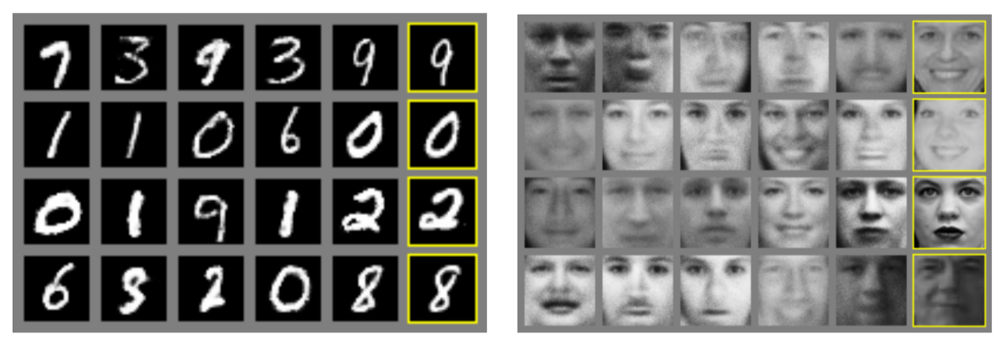
Generative models
Ability to generate/preduce new content
The rightmost column contains true data that are the nearest from the direct neighboring generated samples.
This shows us that the produced data are really generated and not only memorised by the network.
(source: “Generative Adversarial Nets” paper)

Slide 3
Generating a new image of (let’s say) a ”dog” is equivalent to the problem of generating a new vector following the “dog probability distribution” over an N dimensional vector space (generating a random variable with respect to a specific probability distribution).
Issue n.1: the “dog probability distribution” may be a very complex distribution over a very large space;
Issue n.2:we usually don’t know how to express explicitly this distribution

Slide 4
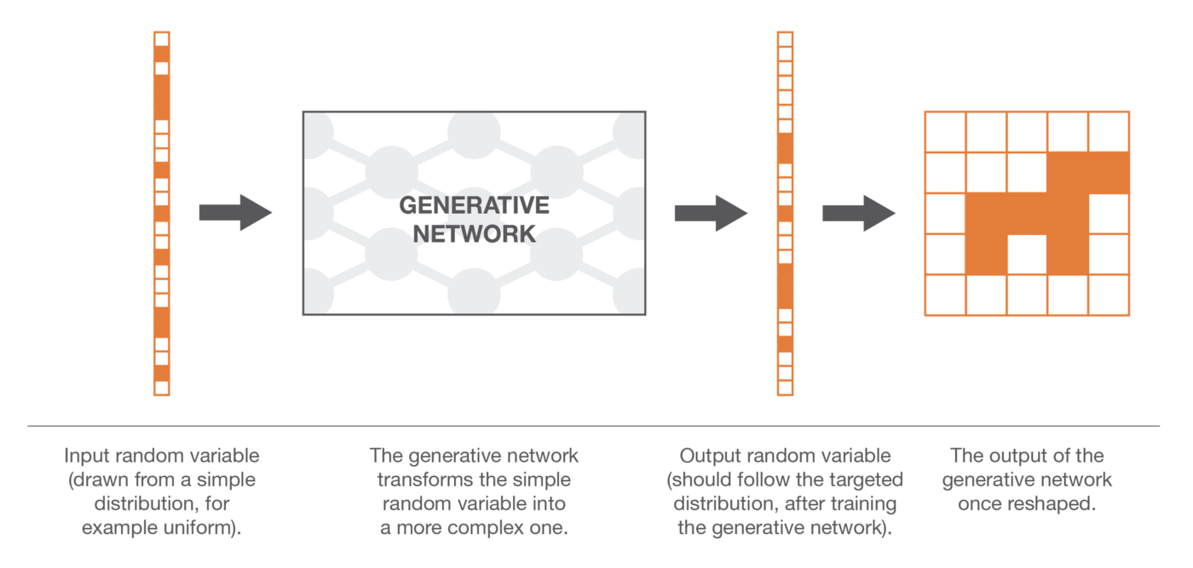
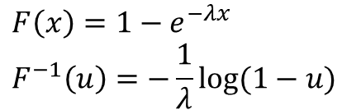
Dealing with complex distributions
“Transform method”: generating random variables as function of some simpler random variables (e.g. inverse transform from uniform)
Idea: implement the transform through a NN
$$F\left(x\right)=1−e^{−λx} \\ F^{−1}\left(u\right)=−\frac{1}{λ}log⁡(1−u)$$
How to train it?

Slide 5
Training methods
Direct training: compare the true and the generated probability distributions and backpropagate the difference (the error) through the network → GMN: Generative Matching Networks
Indirect training: make the two distributions go through a downstream task chosen such that the optimisation process of the generative network with respect to the downstream task will enforce the generated distribution to be close to the true distribution → GAN: Generative Adversarial Networks

Slide 6
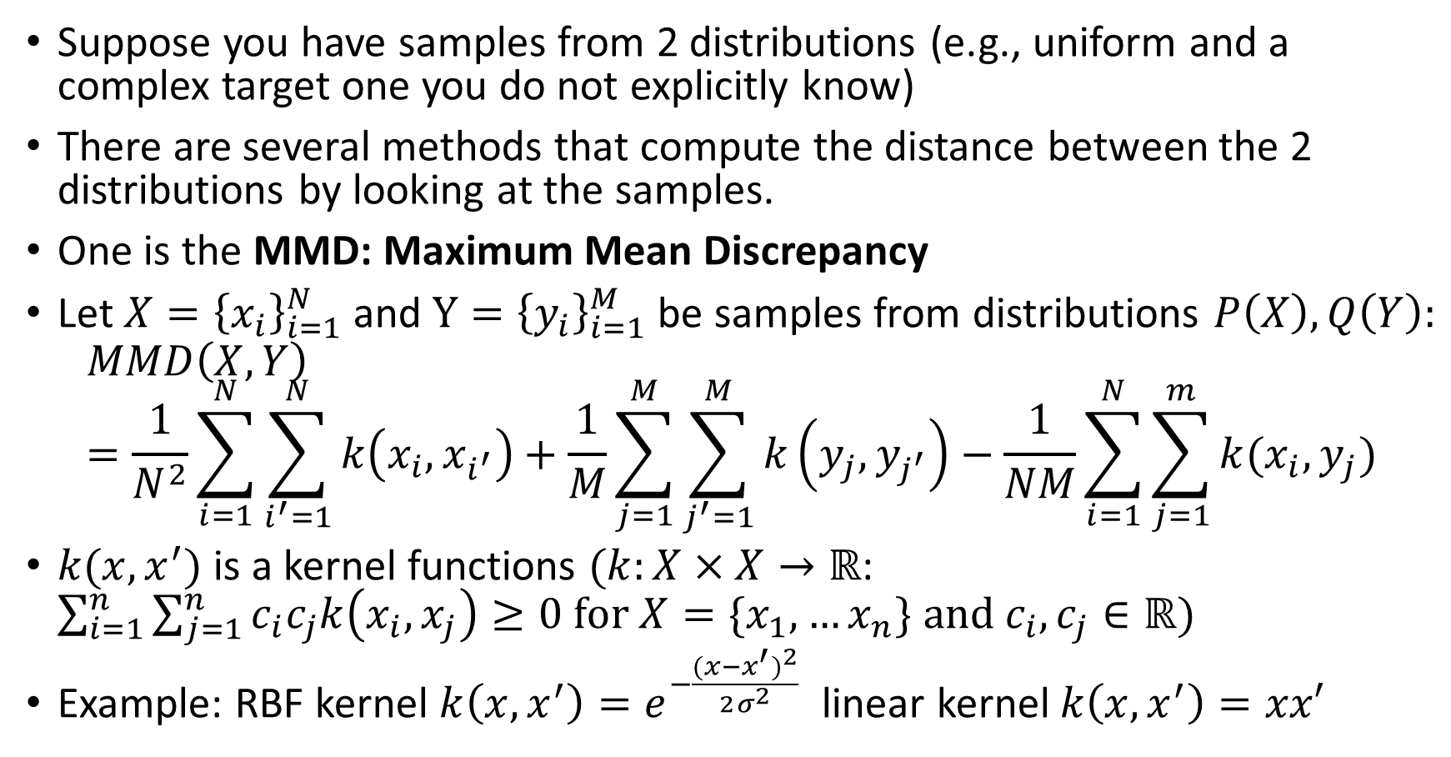
Optional: Comparing distributions over samples
Suppose you have samples from 2 distributions (e.g., uniform and a complex target one you do not explicitly know)
There are several methods that compute the distance between the 2 distributions by looking at the samples.
One is the MMD: Maximum Mean Discrepancy
Let $X={\left\{x_{i}\right\}}_{i=1}^{N}$ and $Y={\left\{y_{i}\right\}}_{i=1}^{M}$ be samples from distributions $P\left(X\right), Q\left(Y\right):$
$$MMD\left(X,Y\right)=\frac{1}{N^{2}}\sum_{i=1}^{N}{\sum_{i^{′}=1}^{N}{k\left(x_{i},x_{i^{′}}\right)+\frac{1}{M}\sum_{j=1}^{M}{\sum_{j^{′}=1}^{M}{k\left(y_{j},y_{j^{′}}\right)−\frac{1}{NM}\sum_{i=1}^{N}{\sum_{j=1}^{m}{k(x_{i},y_{j})}}}}}}$$
$k(x,x^{′})$ is a kernel functions $(k:X×X→ℝ$: $\sum_{i=1}^{n}{\sum_{j=1}^{n}{c_{i}c_{j}k\left(x_{i},x_{j}\right)≥0 \text{for} X=\{x_{1},…x_{n}\} \text{and} c_{i},c_{j}∈ℝ)}}$
Example: RBF kernel $k\left(x,x^{′}\right)=e^{−\frac{{(x−x^{′})}^{2}}{2σ^{2}}}$ linear kernel $k\left(x,x^{′}\right)=xx′$

Slide 7
Generative Matching Networks
Generate some random samples from uniform distribution
Use them as input for the GMN and collect the output samples (forward propagation)
Compare (using MMD) the generated samples with the true samples
Use backpropagation to make one step of gradient descent to lower the distance (for example MMD) between true and generated distributions (i.e., loss function is MMD)
Go to 2 and Repeat until stop criterion

Slide 8
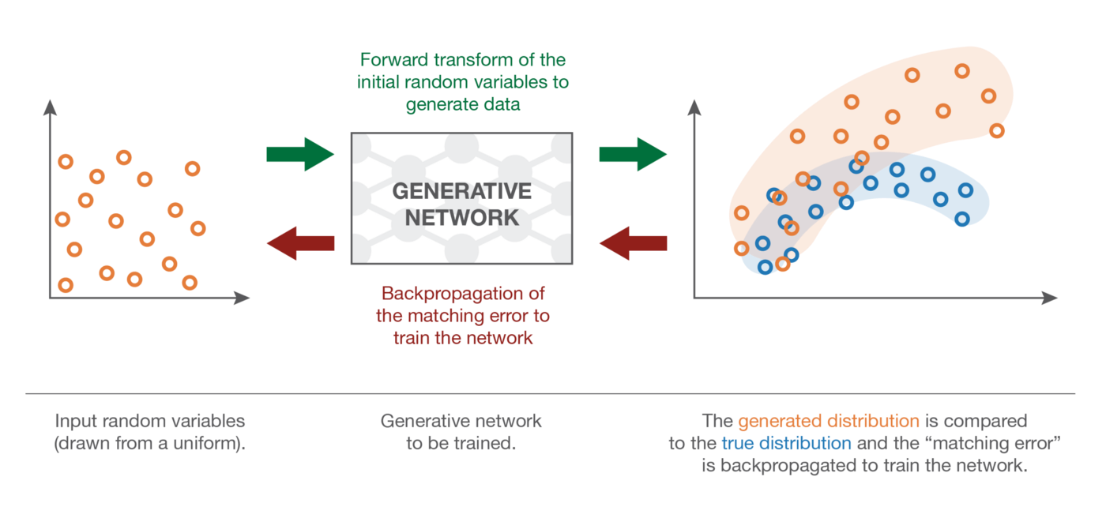

Slide 9
Generative Adversarial Networks
Training the generative network by optimizing a downstream task over the real and the generated distribution
The downstream task of GANs is a discrimination task between true and generated samples
  we want the discrimination to fail as much as possible
GAN modules
  Discriminator: takes samples of true and generated data and that try to classify them as well as possible;
  Generator: generate “fake” samples trying to fool the discriminator as much as possible (generate fake samples increasingly difficult to discriminate from real ones)

Slide 10
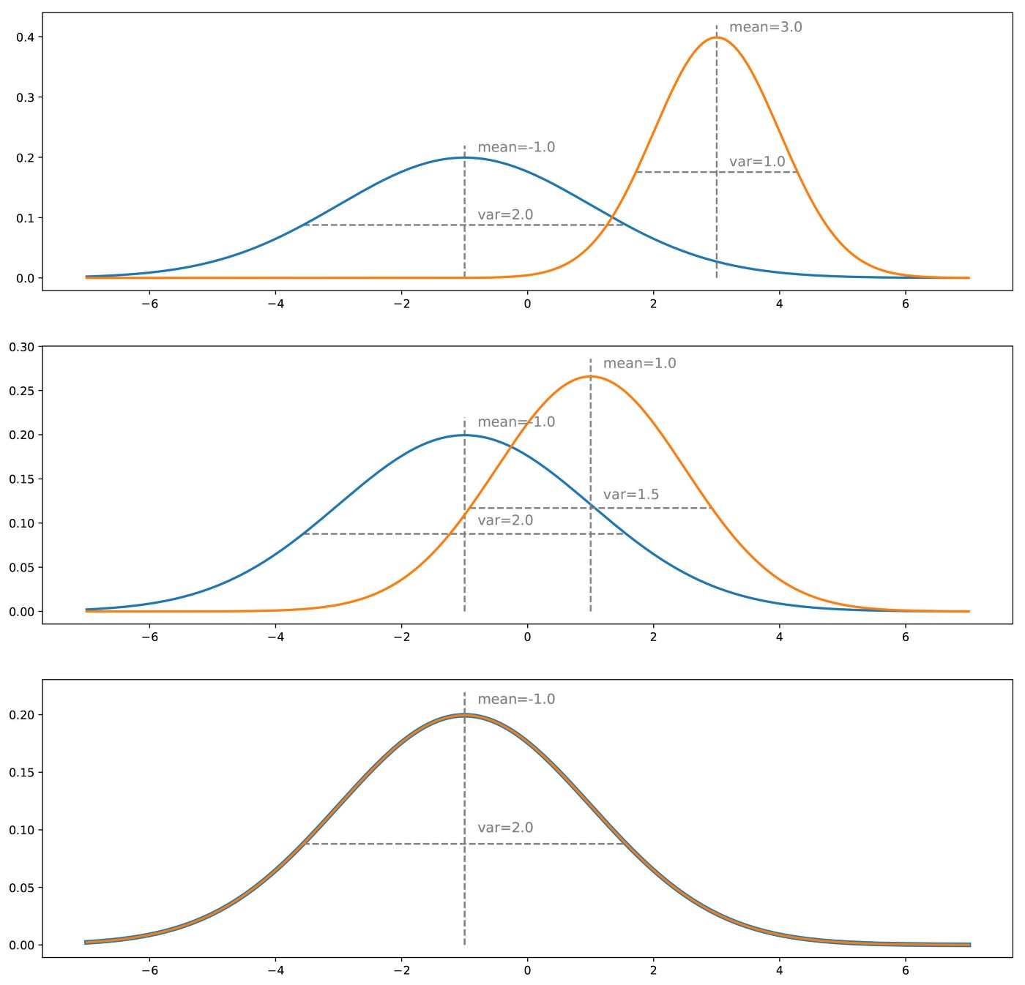
In the direct method we try to
adapt the generated distribution
to fit the actual one,
by adjusting iteratively the generator
(gradient descent iterations) to correct
the measured difference/error between
true and generated distributions

Slide 11
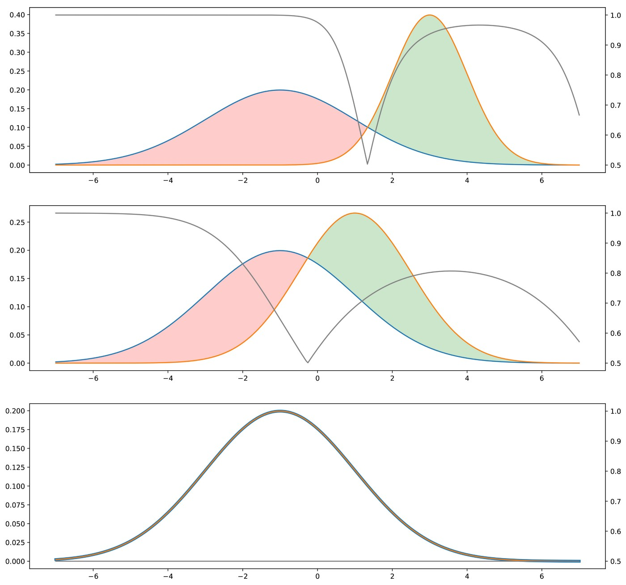
Adversarial method
Suppose discriminator is an oracle
that knows how both distributions are
The blue distribution is the true one, the orange is the generated one.
In grey, with corresponding y-axis on the right, we displayed the probability to be true for the discriminator
if it chooses the class with the higher density in each point (assuming “true” and “generated” data are in equal proportions).
The closer the two distributions are, the more often the discriminator is wrong.
When training, the goal is to “move the green area” (generated distribution is too high)
towards the red area (generated distribution is too low)
When distribution overlap, discriminator
is just “random guessing”

Slide 12
Some considerations
Is generator optimization based on downstream activity worse than direct optimization based on distributions? Usually is not.
How can we use a discriminator if it is not an oracle? It can be learned.
Generator G: a NN that implements a transform function; it takes a random variable following a simple distribution as input, and return a random variable following the target distribution
Discriminator D: a NN that implements a discriminative function; it takes as input a point and returns the probability that the point is “true/fake”

Slide 13
Joint tranining
The two networks G and D can then be trained jointly (at the same time) with opposite goals:
  the goal of G is to fool the discriminator, so the generative neural network is trained to maximize the final classification error (between true and generated data)
  the goal of D is to detect fake generated data, so the discriminative neural network is trained to minimize the final classification error.
At each iteration, the weights of G are updated in order to increase the classification error (error gradient ascent over the G’s parameters) whereas the weights of the D are updated so that to decrease this error (error gradient descent over the D’s parameters)

Slide 14
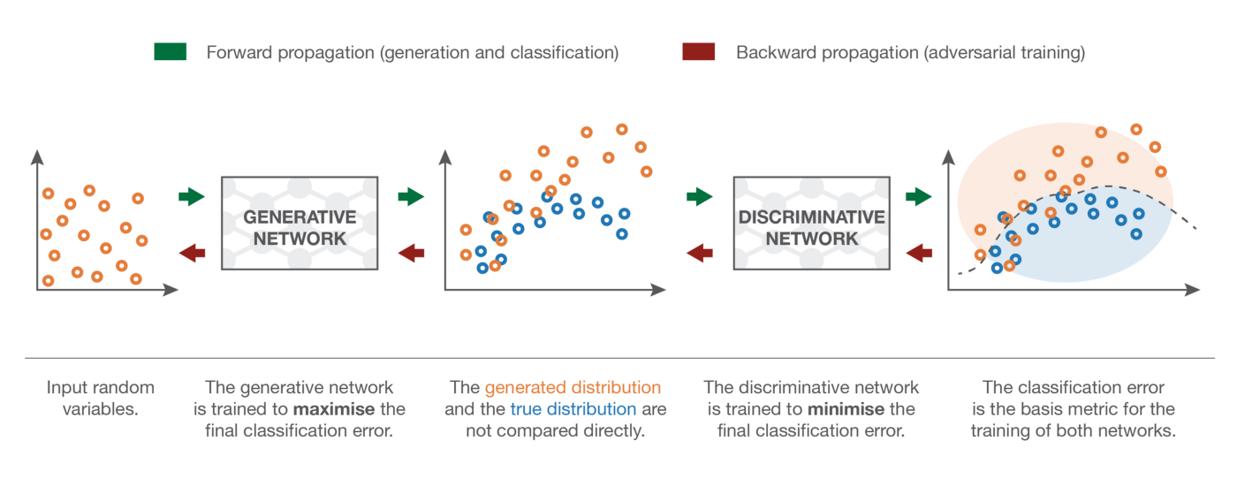
The generator takes simple random variables as inputs and generate new data.
The discriminator takes “true” and “generated” data and try to discriminate them, building a classifier.
The goal of the generator is to fool the discriminator (increase the classification error by mixing up as much as possible
generated data with true data) and the goal of the discriminator is to distinguish between true and generated data.

Slide 15
A game theoretical framework
Each network competes with the other trying to “win”.
A minimax two-players game where the equilibrium is
  G produces data from the exact targeted distribution
  D predicts “true” or “generated” with probability 1/2 for any point it receives
The target of the generator shifts according to the discriminator’s generated error
However, It will be very hard for the generator to do its work if the target or the discriminator error is varying or moving
So the discriminator is not trained during the training of the generator and vice versa: first, we train the discriminator and then we move on to train the generator.

Slide 16
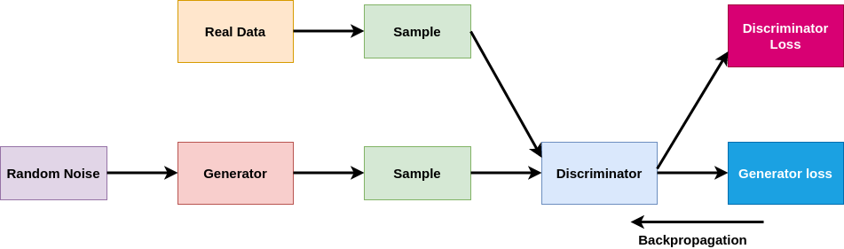
The discriminator loss is only backpropagated to the Discriminator network.
The Generator loss is backpropagated through the Discriminator to reach the Generator.
The weights of the discriminator are frozen during the training of the generator so that they do not get updated due to the backpropagation during generator training.

Slide 17
The procedure for one epoch GAN training:
  Both Generator and Discriminator are initialized.
  Random noise is passed into the generator, for creating fake or generated instances.
  The generated instances along with the real instances are passed through to the discriminator.
  The discriminator tries to classify fake instances as fake and real instances as real
  Discriminator and generator losses are obtained
  Losses are backpropagated and discriminator and generator are trained one after another.

Slide 18
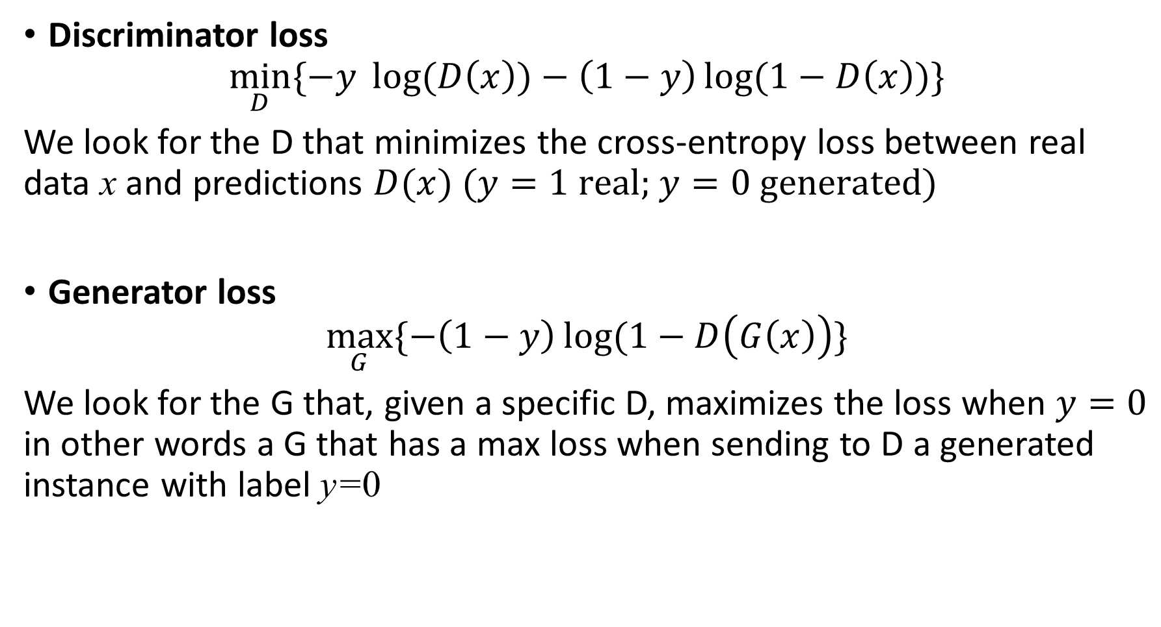
Loss functions
Discriminator loss
$\min_{D}{\{−y \log{(D\left(x\right))−\left(1−y\right)\log{(1−D\left(x\right))\}}}}$
We look for the D that minimizes the cross-entropy loss between real data x and predictions $D(x)$ $(y=1 \text{real}\text{; }y=0 \text{generated}\text{)}$
Generator loss
$\max_{G}{\{−\left(1−y\right)\log{(1−D\left(G\left(x\right)\right)\}}}$
We look for the G that, given a specific D, maximizes the loss when $y=0$ in other words a G that has a max loss when sending to D a generated instance with label y=0

Slide 19
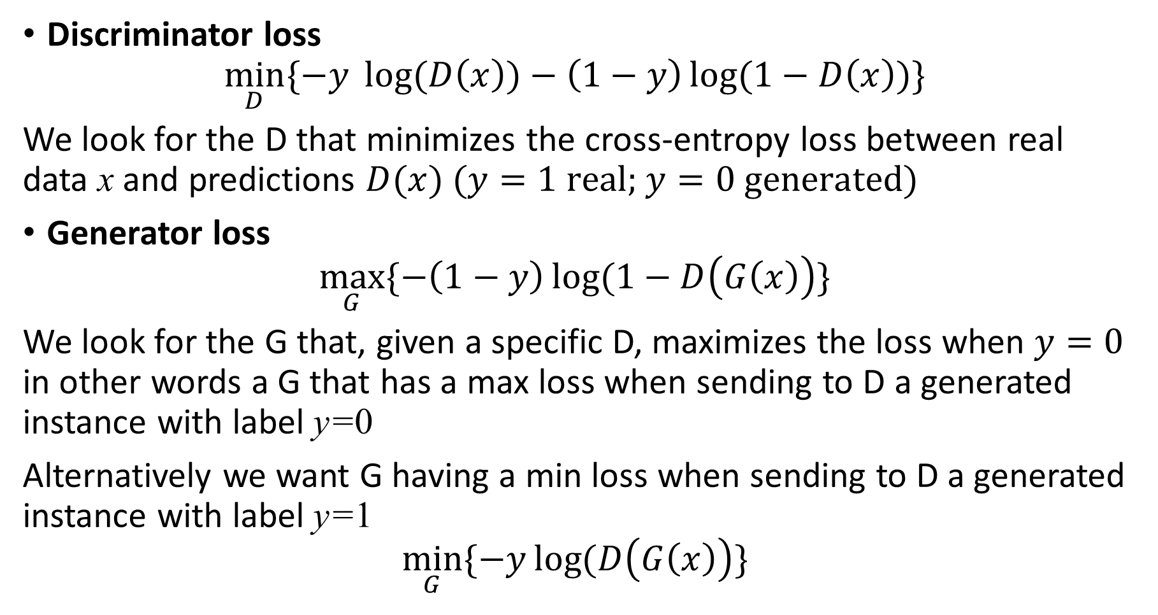
Loss functions
Discriminator loss
$\min_{D}{\{−y \log{(D\left(x\right))−\left(1−y\right)\log{(1−D\left(x\right))\}}}}$
We look for the D that minimizes the cross-entropy loss between real data x and predictions $D(x)$ $(y=1 \text{real}\text{; }y=0 \text{generated}\text{)}$
Generator loss
$\max_{G}{\{−\left(1−y\right)\log{(1−D\left(G\left(x\right)\right)\}}}$
We look for the G that, given a specific D, maximizes the loss when $y=0$ in other words a G that has a max loss when sending to D a generated instance with label y=0
Alternatively we want G having a min loss when sending to D a generated instance with label y=1
$$\min_{G}{\{−y\log{(D\left(G\left(x\right)\right)\}}}$$

Slide 20
Challanges
Initially, D easily differentiates between real and generated instances, so G learns well; after G starts producing generated instances very similar to real instances, the probability of prediction of D for an instance becomes 50%. So, at this point, the generator is trained at an optimal level and learning must stop.
Initially, it is very easy for D to classify. If the loss is very close to 0, it is not backpropagated to G due to the vanishing gradient problem.
Mode Collapse problem: D works well and fails only on a few instances; G learns which instances are fooling D and starts generating only such instances: both D and G stop learning!

Slide 21
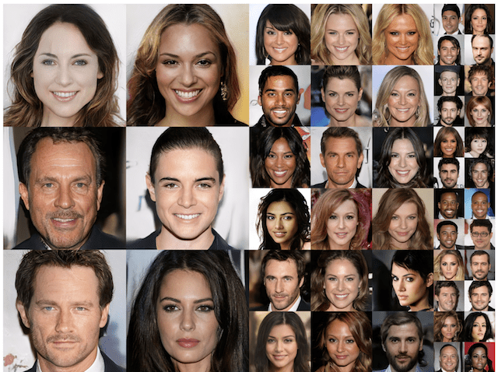
Examples of Photorealistic GAN-Generated Faces.Taken from
Progressive Growing of GANs for Improved Quality, Stability, and Variation, 2017.

Slide 22
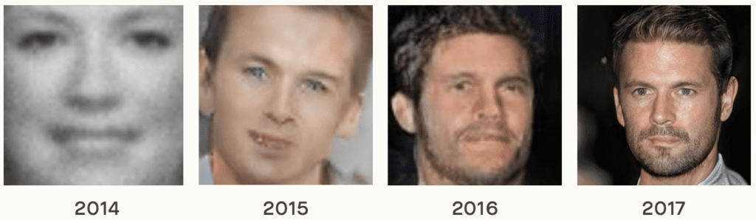
Example of the Progression in the Capabilities of GANs from 2014 to 2017.
Taken from The Malicious Use of Artificial Intelligence: Forecasting, Prevention, and Mitigation, 2018.

Slide 23
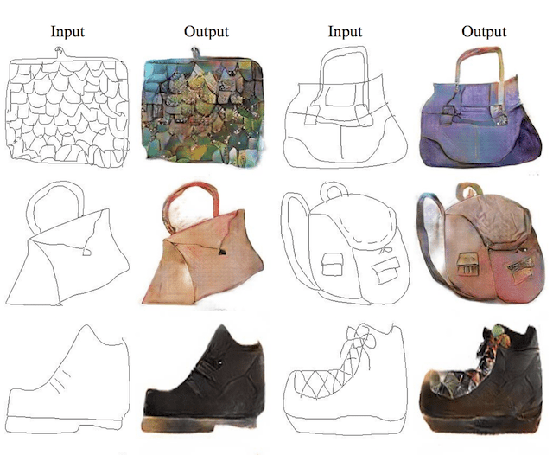
Example of Sketches to Color Photographs With pix2pix.
Taken from Image-to-Image Translation with Conditional Adversarial Networks, 2016.

Slide 24
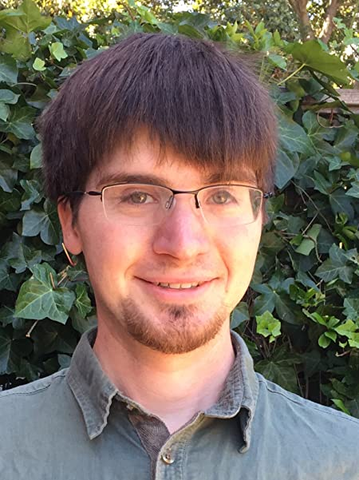
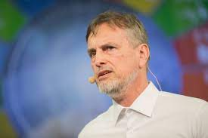
NIPS 2016 controversy
Juergen Schimdhuber (Predictability Minimization)
Ian Goodfellow (GAN)

